Slide 1


Proposals for Database Utilization from a Political Perspective
International Workshop: Utilization of monitoring data and database related to marine plastic pollution
November, 2025
Ola Oresanya
Commissioner , MOE
Ogun State, Nigeria

Slide 2

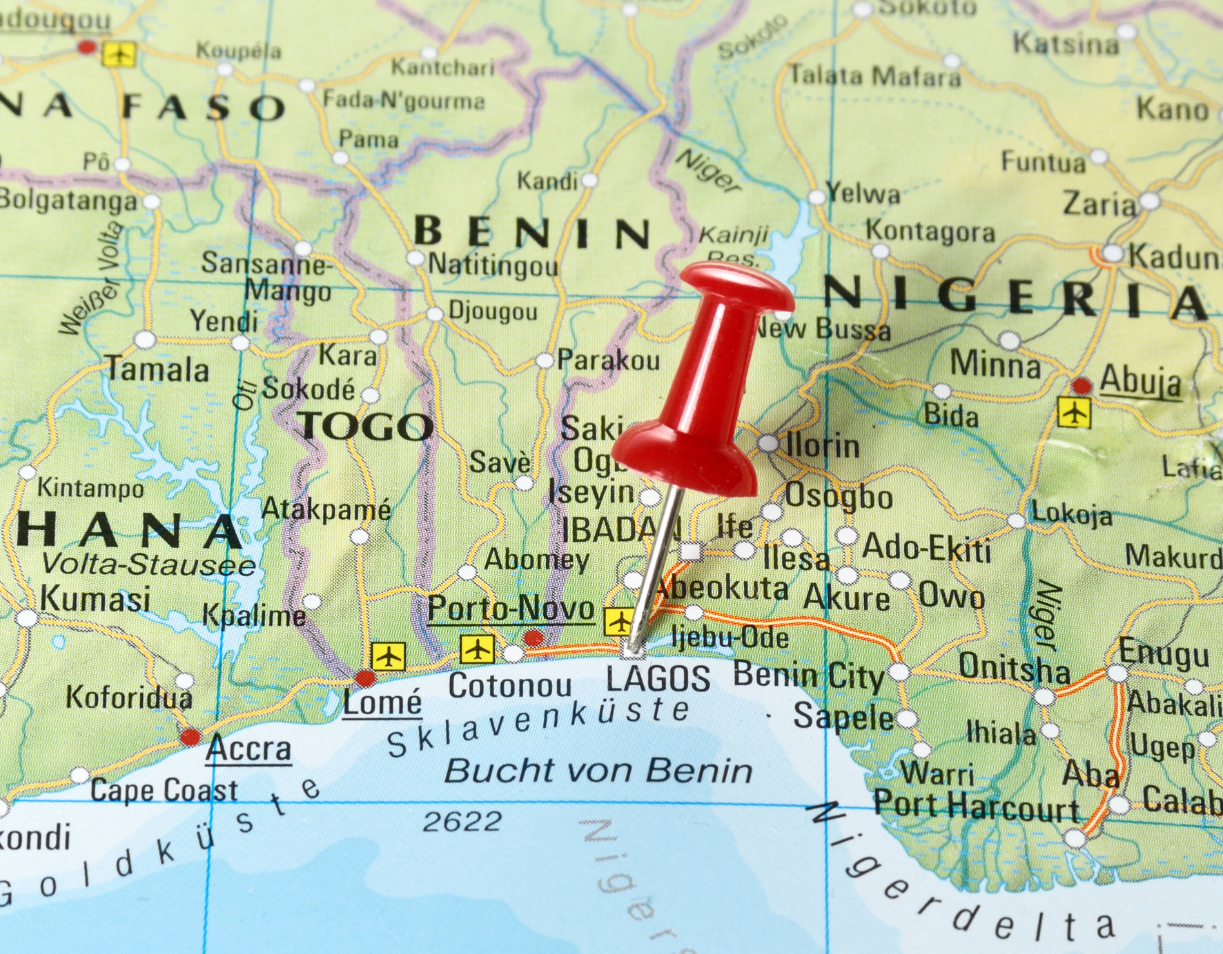
Introduction
Lagos is the second largest city in Africa, after Kinshasa, Democratic Republic of Congo, having a population of 14.8 million as of 2021 within the city proper. The Lagos metropolitan area has a total population of 21.3 million, making it the second-largest metropolitan area in Africa, after Cairo. Lagos is a major African financial centre and is the economic hub of Lagos State and Nigeria at large. The megacity has the fourth-highest GDP in Africa and houses one of the largest and busiest seaports on the continent. It is one of the fastest-growing cities in the world. The Waste Wise Cities Tool was applied through funding made available from the United Nations Environment Programme in 2021.
OGSG-MOE -MOEJ | SDG Progress Report 2025

Slide 3
Data Gathering & Utilization in the Lagos lagoon and the West African coastline
  UN Habitat – UNEP Waste Wise Cities tool, WaCT in conjunction with Global Partnership on Marine Litter (GPML) was deployed for the Lagos plastic leakage study in 2021
  Study was sponsored by the Norwegian Government to assess the environmental performance of municipal solid waste management.
  The study objective was to support the Lagos state government in identifying policy interventions and infrastructure gaps to improve waste collection efficiency and reduce marine litter.
  Other studies on marine litter pollution in Lagos lagoon was conducted in 2016 by Nigerian Maritime Authority, NIMASA
  Other published studies include the progressive waste operation in Lagos, Nigeria by Oresanya and Olukanmi … published by ISWA in 2016

Slide 4
Data Gathering & Utilization in the Lagos lagoon and the West African coastline cont...
The use of the waste flow diagram (WFD) and SWEET ( designed by USEPA) was used for the estimation of potential plastic leakage from Lagos MSW. The WFD allows for data deployment for SDG indicator 11.6.1 to be utilized for policy decisions.
WFD allows for the material flow analysis for the entire waste stream of Lagos …….
Total recovered material (t/day )
City Recovery rate= ___________________________ X 100%
Total MSW generated (t/day)
Over 70 % of marine litter in Lagos coastal area is traceable to land-based activities while the remaining is traceable to ocean economic activities and inter-regional cross-border plastic waste movement.

Slide 5
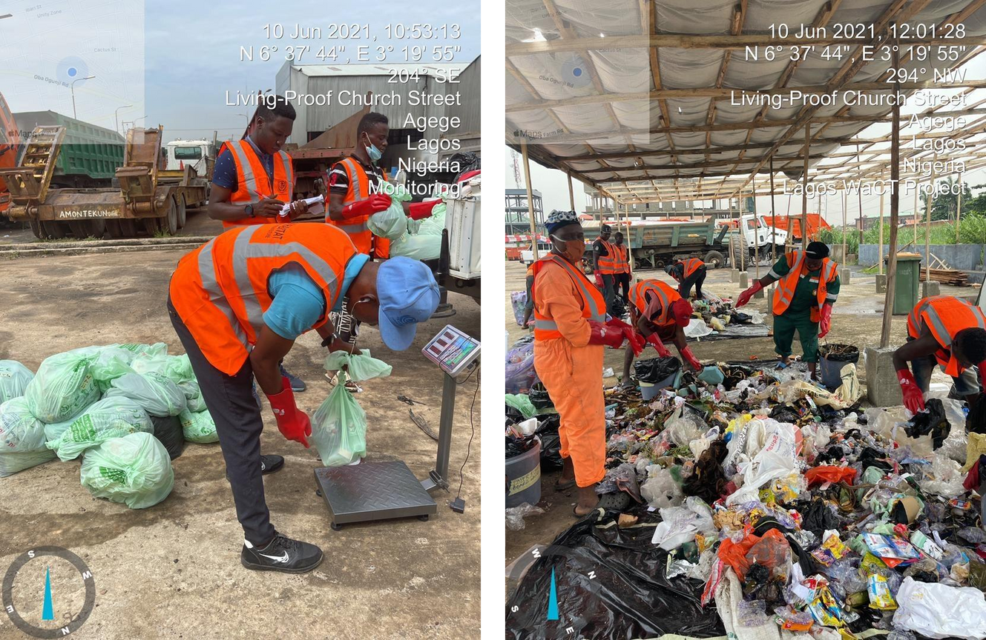

WaCTin Lagos in 2021

Slide 6
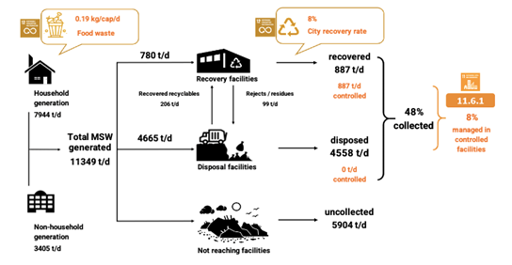


WaCT Flow

Slide 7
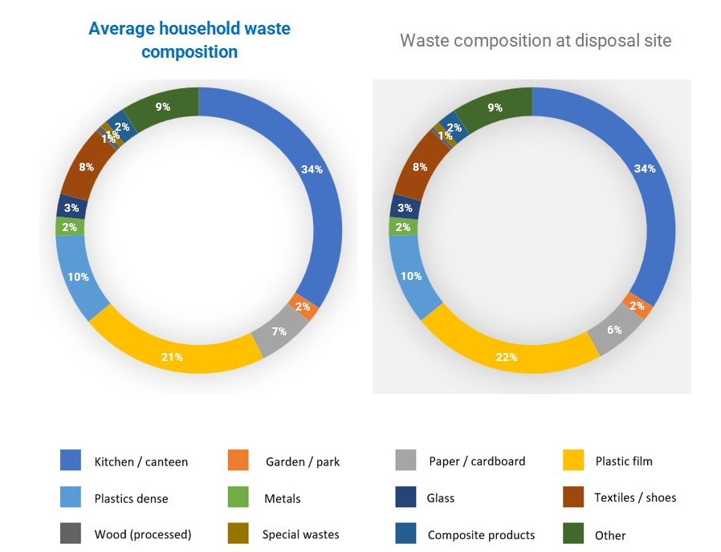
Waste Composition ->30% plastic

Slide 8
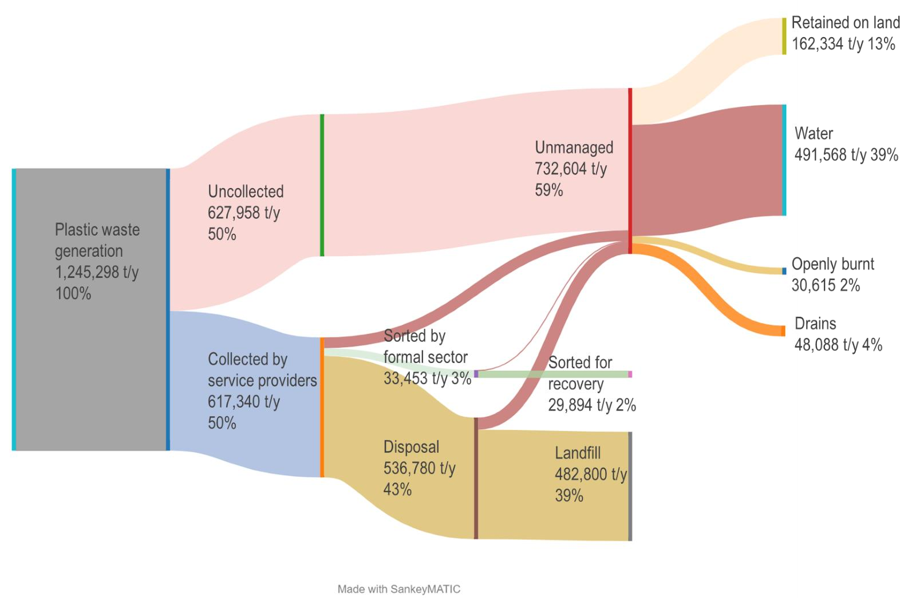

Plastic Waste Flow
34.2kg/person/year of plastic leaking to water

Slide 9
Institutional & Governance system
National law: Environmental Management and Protection Law, 2017
Lagos Waste Management Authority, LAWMA is responsible for MSWM system including:
• • • •
datacollection
adapting national policies and establishing implementation directives collection, transport and disposal of MSW and industrial waste establishment of WM infrastructure

Slide 10

Waste Collection
52% uncollected
•Waste collection services are outsourced to private operators (approx.
420 waste collectors) -door-to-door collection, curb side and communal collection points
•A significant number of informal workers are also present, particularly in
low-income and rural areas where poor road conditions do not allow
compactor trucks to operate
•In low-income areas 500 NGN (0.65 USD) -2000 NGN (2.6 USD) per
month, high-income areas -3800 NGN (5 USD) per month. In certain
cases, charges are levied per container, ranging from 5000 to 10000 NGN (6-13 USD) per month.

Slide 11
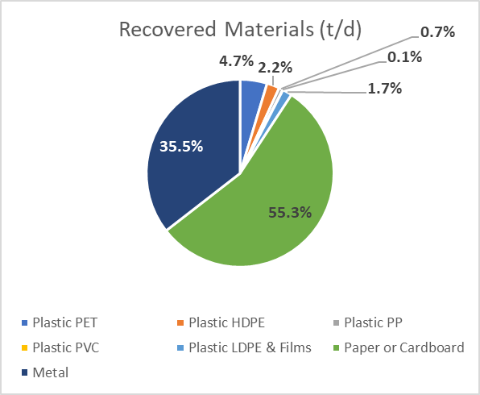
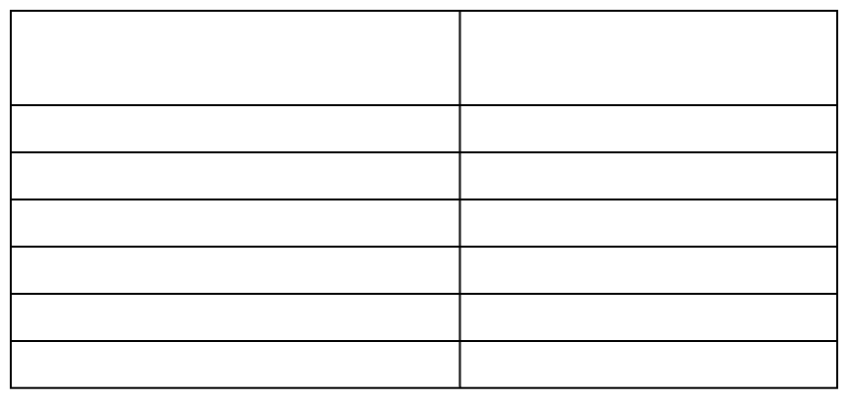

Waste Recovery
887 t/d (8%) being recovered
Waste category
Recoverable waste
potential(t/d)
Paper and cardboard Plasticfilm Plastic dense Glass Organics Total
213 746 2,433 245 3,872 8,688

Slide 12


Data Quality and Utilization Methodologies
  Use for Social Perception
  Validation of Previous Data and Research Records
  City Pair Review
  Institutional acceptance and validation with
  Use of WFD and SWEET has proven records of credibility
  Tested in Lagos and Abuja in Nigeria with similar records of plastic leackage

Slide 13
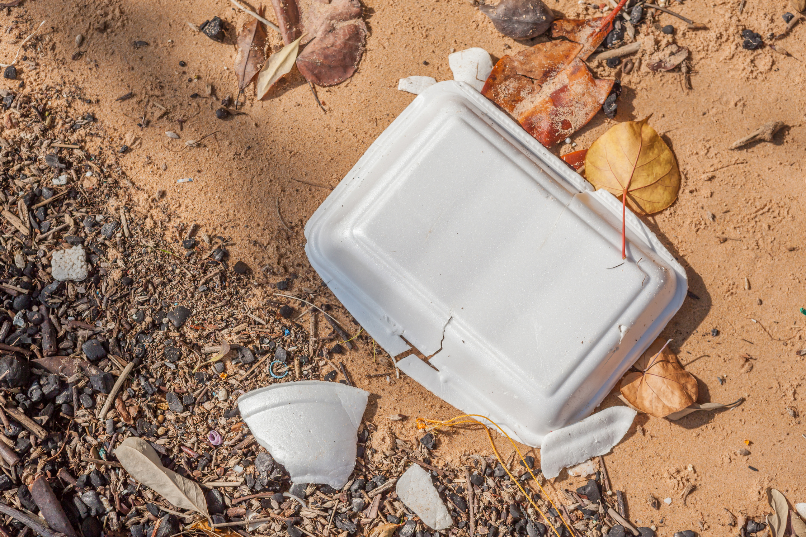
Capacity and Development
Challenges for Data Monitoring and Application.
  Awareness gap among coastline cities of the available tools for data gathering on marine litter
  Ease of understanding the available tools for use by average field officer
  Poor internet coverage in Lagos and other west African coastline cities
  Use of the WACT tools for continuous data gathering to monitor impact of policy decision periodically
  Indicators of impact for leakage of marine litters for quick response

Slide 14

Politics and Benefits of Data Sharing and Application.
  Data confidentiality and mis-application
  Intent of data use
  Data interpretation as a tool of efficiency and budgeting
  Policy statement and data variance
  Politics of data application

Slide 15
Global benefits of Regional Integration of Database Application
  Need for identification of coastal cities of impact along the West African sub-region and deployment of the WACT study for plastic leakage mapping.
  Data confidentiality agreement to give comfort to policymakers.
  Data sharing among cities for policy enactment and monitoring.
  Engage academia for research in microplastic monitoring and impact assessment within local coastal areas and share results with global agencies.
  Establish agencies that will focus specifically on the prevention of plastic leakages by deploying innovative solutions that addresses local peculiarities. The blue box (trash for cash program).
  Full implementation of polluter principles and EPR.

Slide 16

Challenges associated with data gathering and application
  Poor institutional support for data gathering by the supervisory agencies of the government with limitations from the data protection laws
  Poor knowledge of the impact of science-based facts in policy-making by political office-holders
  Difficulty in the provision of access to records of precious studies and data on MSW
  Bureaucracy associated with decision-making
  High turnover of political office holders
  Lack of compliance with global treaties
  Poor framework for policy implementation at the national level
  Poor enforcement of the EPR regulations
  Inadequate incentives for the use of alternatives to plastics
  Fossil fuel as a major national income earner and the conflicts of interest with the ban on plastic.

Slide 17
Recommendations
01
Strengthen Global alliance
02
Databank accessibility
For local capacity development for data gathering and monitoring of plastic leakage in the ocean
Global platform for ease of accessibility to data must be given priority to the intent and objective the Atlas of ocean microplastics
03
Adoption of acceptable model
04
Implementation framework
WaCT method should be considered as a reliable method for the global marine litter data gathering and evaluation
The framework for action on marine plastic litter should be domesticated in the black spot regions with data on significant plastic leakage associated with low waste collection efficiency
05
Legal framework
06
Marine litter black spots
Data protection laws and institutional actions on marine litter management must embrace science policy decisions with priority on data gathering for policy implementation
Regional hot spots should be adopted into the global framework to play leading roles in data gathering and monitoring using a harmonized method

Slide 18
Recommendations
07
Planning and research
08
Standardized checklist
Results findings from adequately funded research must be published and made available as a guide for policy stakeholders for ease of making decisions in line with the global aspirations.
Adaptable checklist should be be made available for centre of interest for high plastic leakage into the world ocean
09
Deployment of technology
10
Science policy interface
The use of artificial intelligence should be encouraged in the research for data credibility and interrogation.
There’s need for deployment of available data to interface with policy makers on the risk associated with global impact of marine plastic pollution.

Slide 19


Conclusion
“What is not measurable is not manageable “
“Established facts from credible scientific data administration is the bedrock of effective governance and deployment of common resource through policy enactment”

